Slide 1
BeerDataScienceProject
-presented by
Shilpa Kewalaramani

Slide 2
Table Of Contents
Introduction & Objective
Exploring More About Columns
Details of Columns
Visualization of Data
Presence of Null Data
Statistical Description
Questions and Answers
Steps to Run the Project

Slide 3
Introduction & Objective
The Beer Challenge Analysis Project dataset has the data related to beer reviews which contains information regarding beers on the basis of the reviews collected by the users. The dataset has fields like Beer id, Beer_Style, Beer Appearance, Beer Aroma and many such columns.
There are Total 5,28,870 rows and 13 columns
Objective
The main objective behind this analysis project is to answer some questions after taking the insights from the dataset provided

Slide 4
Exploring more about Columns
Details of ColumnS
Visualizing Numerical Columns
Visualizing Categorical Columns

Slide 5
Details of Columns
beer_ABV means = Here ABV means Alcohol By Volume , beer_ABV means the percent of alcohol present in beer
beer_beerId = Its the id assigned to different beers
beer_brewerId = It is the id of a place where beer is made commercially.
beer_name = It is the name of the beer
beer_style = Beer styles differentiates & categorise beers by colour, flavour, strength, ingredients, production
review_appearance = The beer_appearance means the beer looks in color
review_palette = Rating based on how the beer interacts with the palate
review_overall = Overall review points given by the user
review_taste = Rating based on the taste of beer
review_profileName = Name of the person who reviewed the beer
review_aroma = Rating based on the smell of the review
review_text = Reviews in text written by the user
review_time = Timestamp when the review was recorded

Slide 6
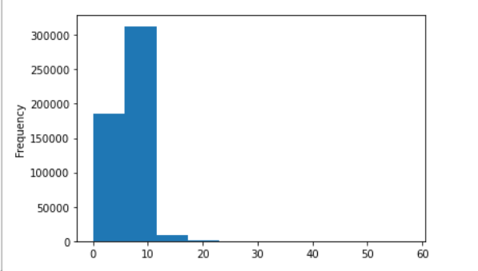
Visualizing Numerical Columns
beer_ABV
There are 283 different beer_ABV recorded,
Minimum Beer_ABV recorded is 0.01 and
maximum recorded is 57.7,
maximum Beer_ABV lies between the range of 0 to 10

Slide 7
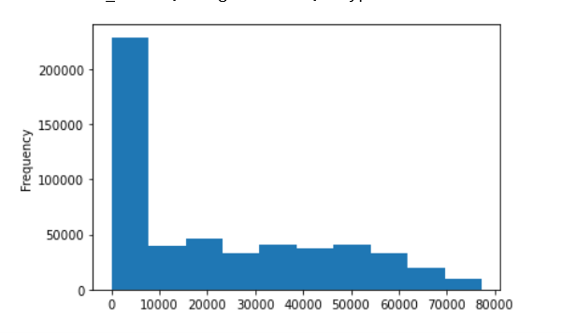
Visualizing Numerical Columns
beer_beerId
There are 20,200 unique beer_beerId
Minimum beer_beerId is 3
Maximum beer_beerIdis 77310
Maximum beer_beerId ranges between 0 to 10,000

Slide 8
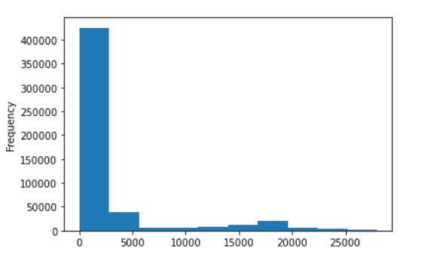
Visualizing Numerical Columns
beer_brewerId
Minimum beer_brewerId is 1
Maximum beer_brewerId s 27980
Maximum beer_brewerId ranges between 0 to 5000
there are 1803 unique beer_brewerId

Slide 9
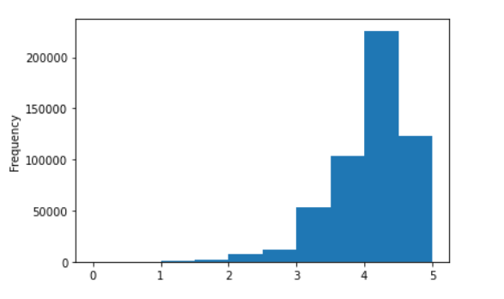
Visualizing Numerical Columns
beer_appearance
Minimum review_appearance is 0.0
Maximum review_appearance is 5.0
Maximum review_appearance ranges between 4 to 5

Slide 10
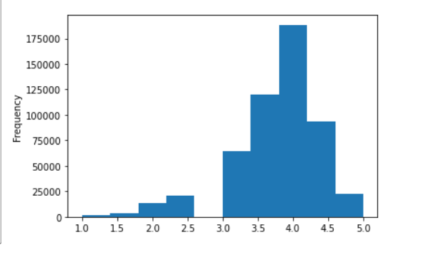
Visualizing Numerical Columns
review_palette
* Minimum review_palette is 1.0
* Maximum review_palette is 5.0
* Maximum review_palette ranges between 3.5 to 4.0

Slide 11
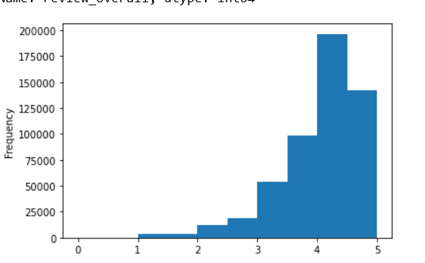
Visualizing Numerical Columns
review_overall
Minimum review_overall is 0.0
Maximum review_overall is 5.0
Maximum review_overall ranges between 4 to 5

Slide 12
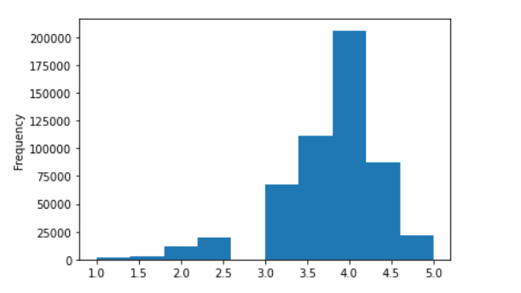
Visualizing Numerical Columns
review_taste
Minimum review_taste is 1.0
Maximum review_taste s 5.0
Maximum review_taste ranges between 3.75 to 4 or 4.25

Slide 13
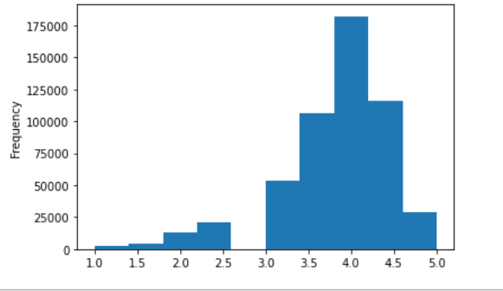
Visualizing Numerical Columns
review_aroma
Minimum review_aroma is 1.0
Maximum review_aroma s 5.0
Maximum review_aroma ranges between 3.75 to 4 or 4.25

Slide 14
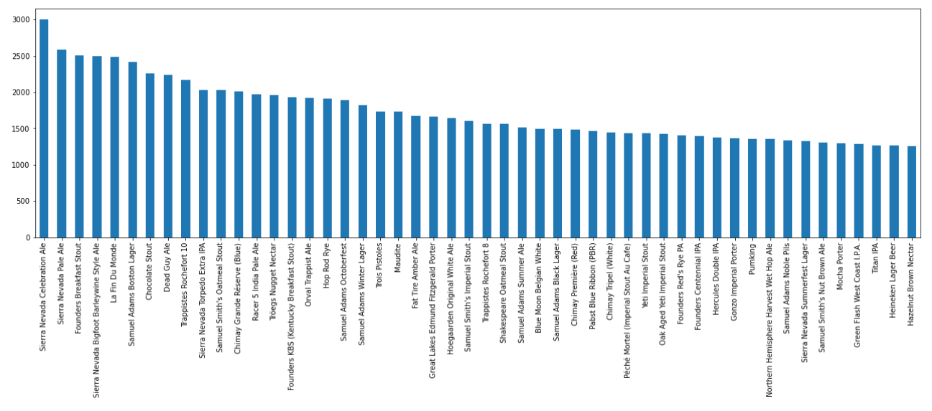
Visualizing Categorical Columns
There are total 18339 different names of beer observed in the dataset
Maximum beer consumed by user is Sierra Nevada Celebration Ale

Slide 15
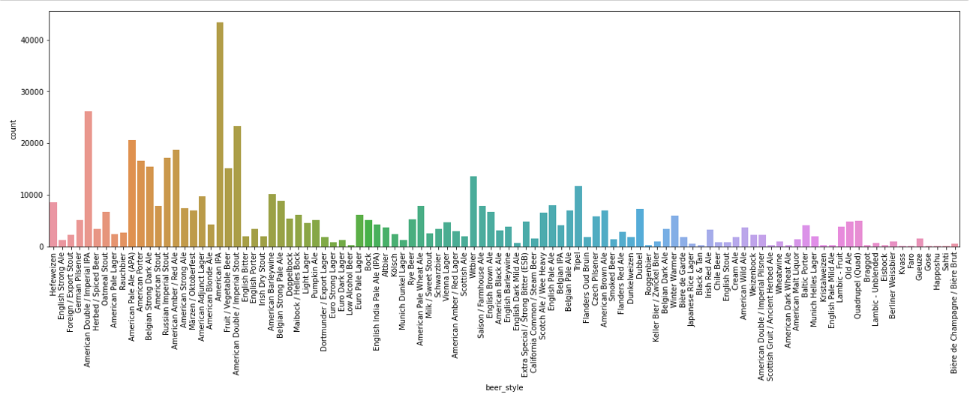
Visualizing Categorical Columns
There are total 104 different styles of beer observed in the dataset
Maximum beer style consumed by users are 'American IPA '

Slide 16
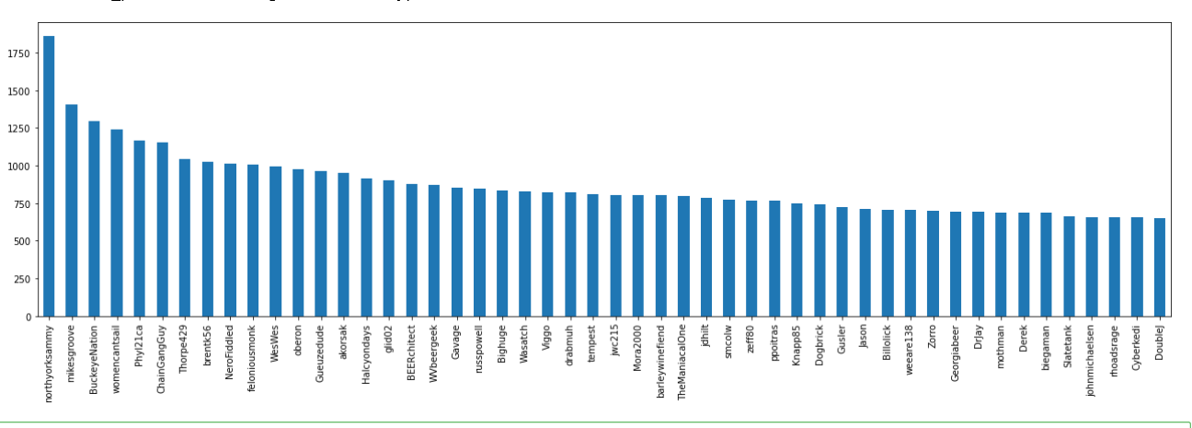
Visualizing Categorical Columns
There are total 22,800 consumers of beer who reviewed the beer observed in the dataset
Maximum beer reviews are given 'northyorksammy'

Slide 17
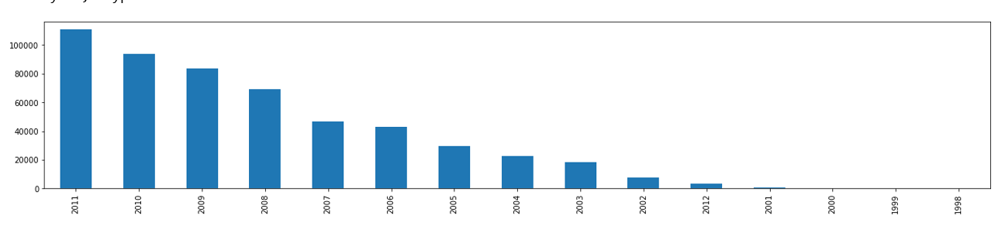
Visualizing Year Column
Maximum reviews are collected during the
year 2011,
from 1998 the reviews are gradually increasing

Slide 18
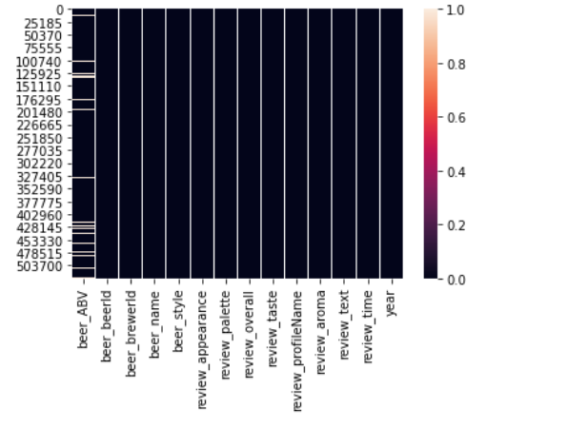
Visualizing Null Values present in dataset
Null Values
White Horizontal lines in the figure shows the null values
3.83 % of data was NULL
beer_ABV columns has 20280 Null values
review_profileName has 115 Null values
review_text has 119 Null values
Null Values were replaced with mean and mode.

Slide 19
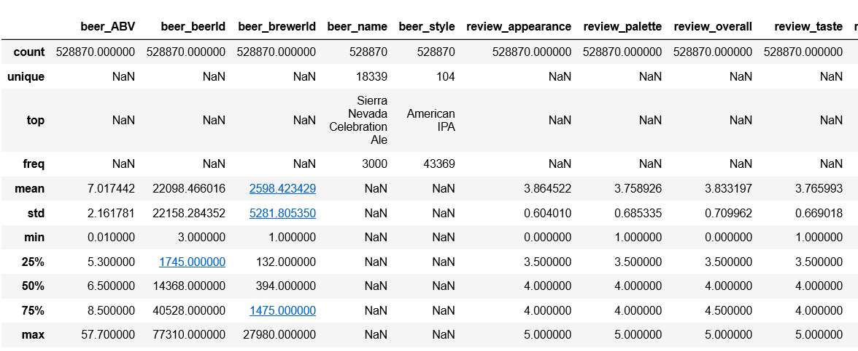
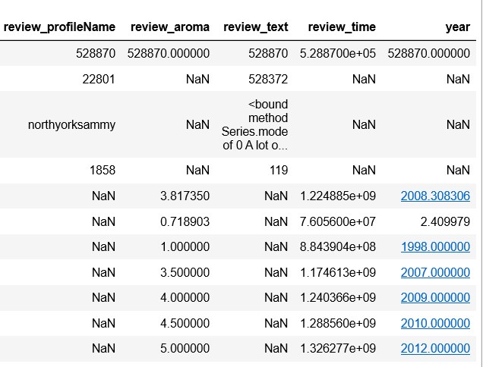
Statistical Description

Slide 20
Statistical Description Continued
* The columns that are showing NAN are categorical columns.
* It can be observed that in beer_name Sierra Nevada Celebration Ale is on top with a frequency of 3000
* in beer_style American IPA is on top with frequecny of 43369
* In review_profileName northyorksammy is on top with frequency 1858
* The difference between the 75% percentile and maximum of beer_ABV is remarkable, it means outliers are present
* The difference between 75% percentile and maximum of beer_brewerId is also more but as it is Id number so it can be in that range

Slide 21
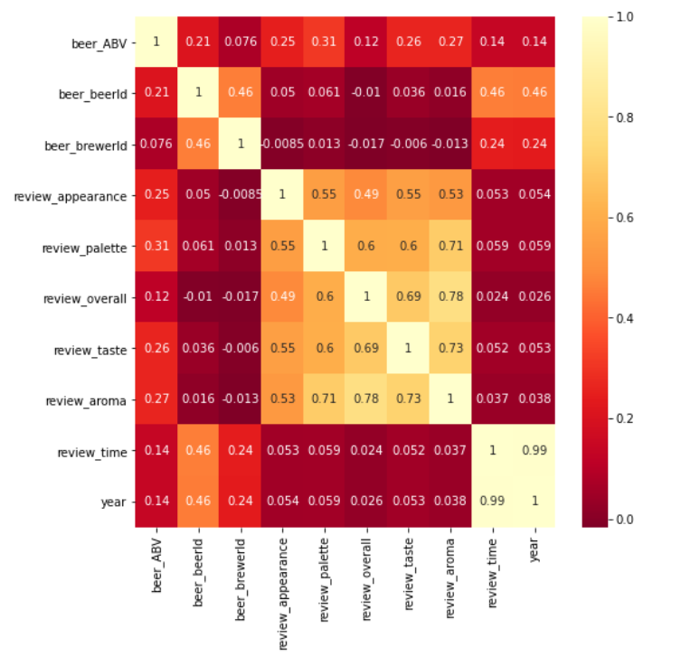
Statistical Description
Correlation between
columns
review taste and review aroma are highly correlated with each other
review taste and review overall are also highly correlated with each other

Slide 22
Questions And Answers

Slide 23
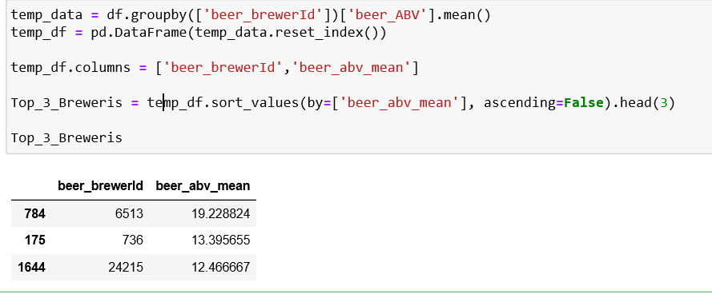
1. Rank top 3 Breweries which produce the strongest beers?
Here strongest beers indicates the strong presence of alcohol in the beer. so we have to find out top 3 beer_brewerId using mean of beer_ABV
So Top Three breweries are ,
Brewerid no 6513, 736 and 24215.

Slide 24
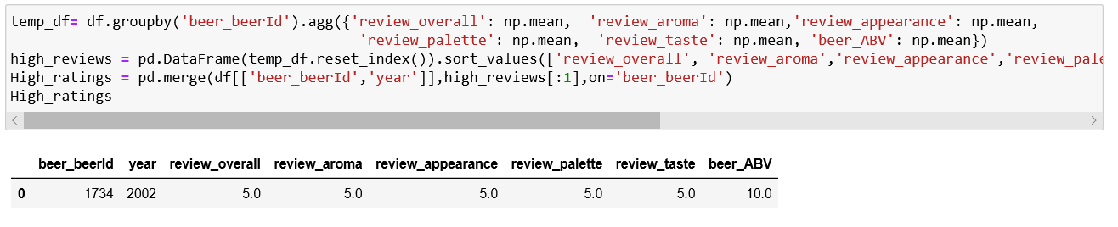
2. Which year did beers enjoy the highest ratings?
to find out highest ratings of beer we need to groupby beer_id and we also need to take highest counts of all other factors like review appearance, review_aroma, review_overall, review_palettte, and review_taste
so the year that encountered highest rating was 2002

Slide 25
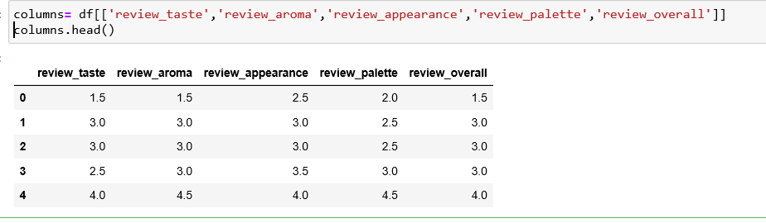
3. Based on the user’s ratings which factors are important among taste, aroma, appearance, and palette?
To find the important factor, all the factors need to be considered along with overall_review and the column showing highest correlation with review_overall can be considered as importan

Slide 26
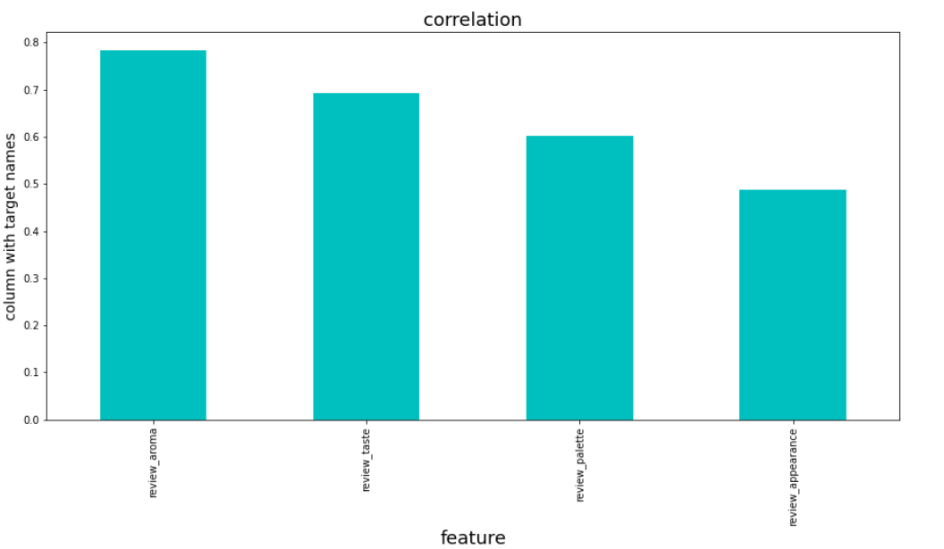
3. Based on the user’s ratings which factors are important among taste, aroma, appearance, and palette?

Slide 27
3. Based on the user’s ratings which factors are important among taste, aroma, appearance, and palette?
From the bar graph it can be considered that important factors are¶
1) review_aroma
2)review_taste
3)review_palette
4)review_appearance

Slide 28
4. If you were to recommend 3 beers to your friends based on this data which ones will you recommend?¶
Finding top 3 beers to recommend to friend is similar like finding the year with highest rating, here I will use groupby function on beer_name and highest count (mean ) on all factors like beer_ABV', 'beer_beerId', 'beer_brewerId', 'beer_name', 'beer_style','review_appearance', 'review_palette', 'review_overall', 'review_taste','review_aroma',

Slide 29
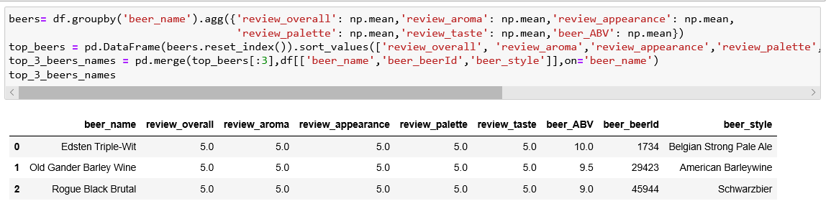
4. If you were to recommend 3 beers to your friends based on this data which ones will you recommend?¶
Top 3 beer names to recommend to friends are
Edsten Triple-Wit
Old Gander Barley Wine
Rogue Black Brutal

Slide 30
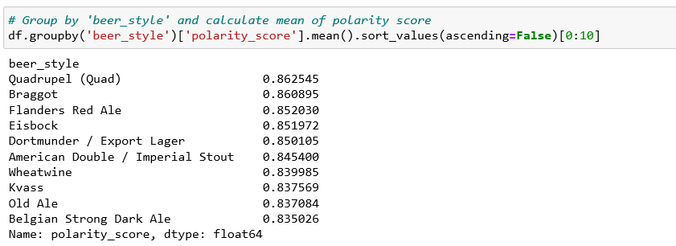
5. Which Beer style seems to be the favorite based on reviews written by users?
For finding the favourite beer style this we need to preprocess, train and do sentiment analysis of reviews considering beer style as target and review_text as feature and finally using groupby function on polarity_Score of beer style we will find top 10 Beer styles

Slide 31
5. Which Beer style seems to be the favorite based on reviews written by users?
On the basis of written reviews following Beer Styles seems to be favourite
1) Quadrupel (Quad)
2)Braggot
3)Flanders Red Ale
4)Eisbock
5)Dortmunder / Export Lager
6)American Double / Imperial Stout
7)Wheatwine
8)Kvass
9) Old Ale
10) Belgian Strong Dark Ale

Slide 32
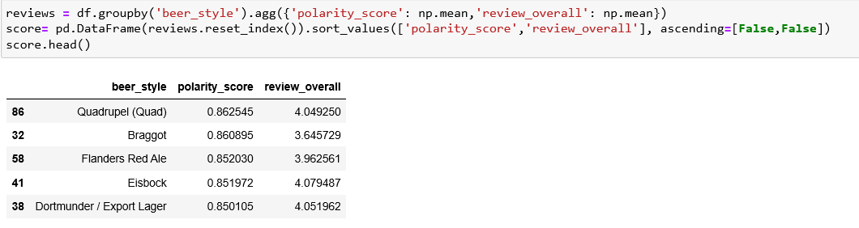
6. How does written review compare to overall review score for the beer styles?
we will find it using mean of polarity_score and mean of review_overall on beer_style with groupby function

Slide 33
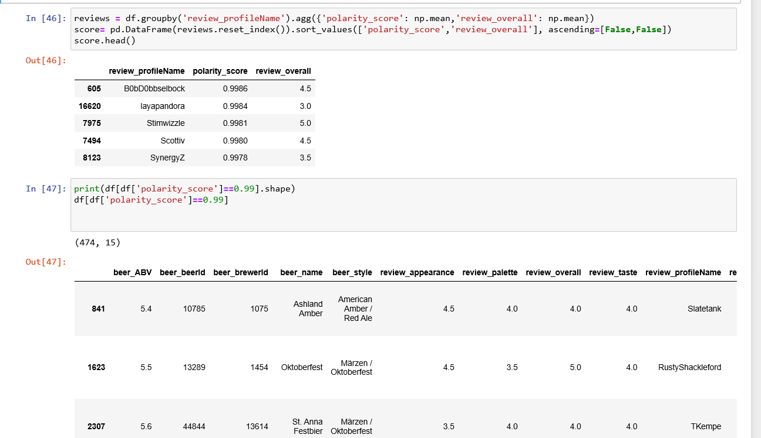
7. How do find similar beer drinkers by using written reviews only?
By using polarity_score we can find the beer drinkers with similar written reviews, like the review_profilename who has same polarity_score simply means their reviews are similar

Slide 34
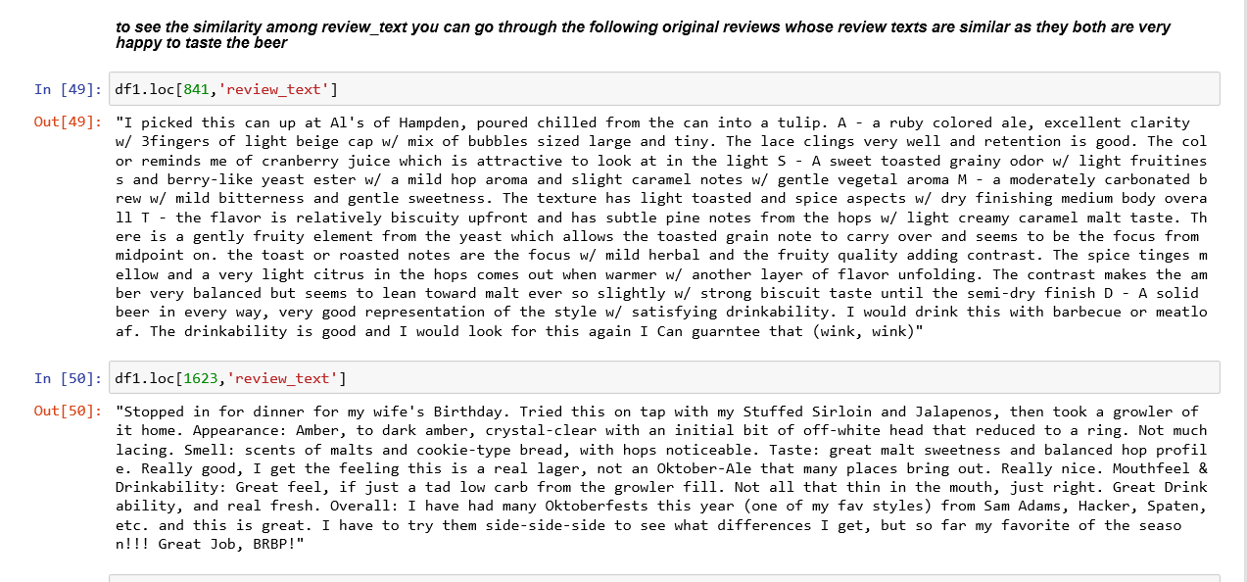
7. How do find similar beer drinkers by using written reviews only?
Here I have reloaded the original database to see the original reviews of ProfileNames with similar Polarity_score

Slide 35
Steps To Run the Project
Anaconda Jupyter Notebook
Google Colab Notebook

Slide 36
1) Anaconda’s Jupyter Notebook
Download the Anaconda from https://www.anaconda.com/
i) click on Products
ii) Click on Anaconda Individual Edition
iii) Click on Download
iv) Install it
v) It will open a window with multiple file running options like Pycharm, Spyder,VSCODE etc and Jupyter Notebook, Install on Jupyter Notebook from it.
2)Download the BeerDataScience.zip folder from the github link and extract it in your local system.
3)Open the Anaconda Jupyter Notebook , click on the upload button and upload the
BeerDataScienceProject.ipynb and BeerDataScienceProject.csv file from the extracted folder

Slide 37
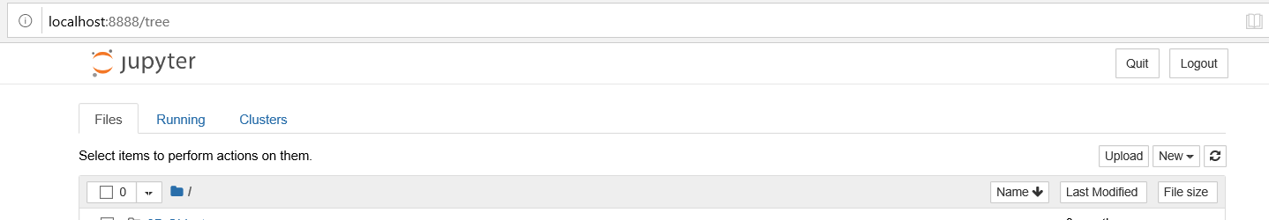
4) Double click on the BeerDataScienceProject.ipynb file
it will open the new tab

Slide 38
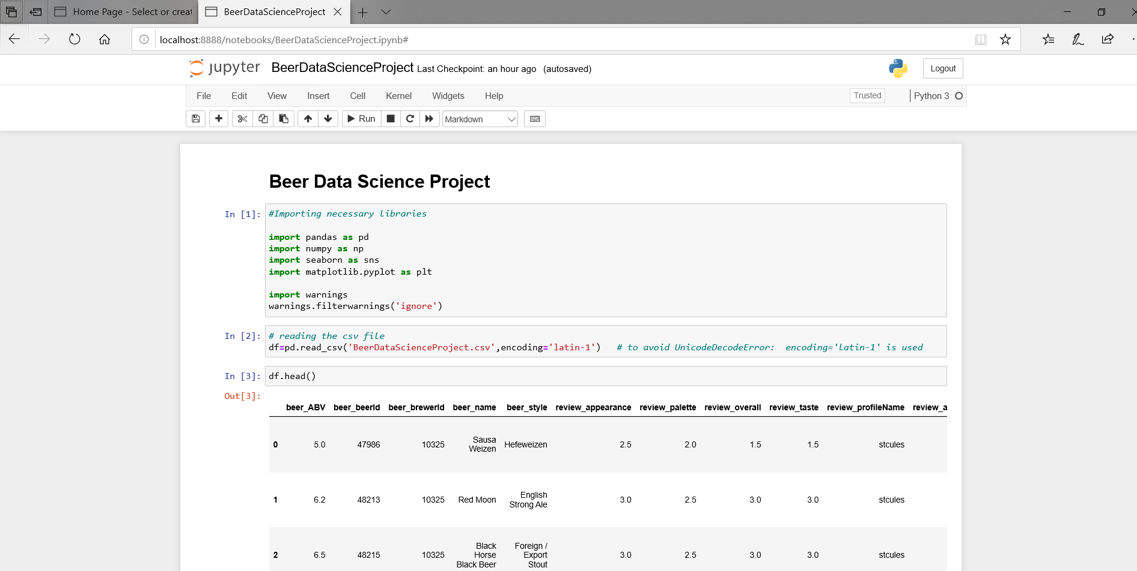
5) Click on Cell button and select the option of Run All option to run the entire file

Slide 39
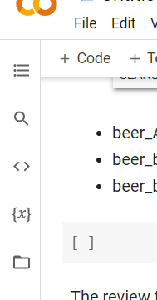
2) Google Colab Notebook
1) Copy this link and paste it in the Google Search Tab
https://colab.research.google.com/drive/1dEJiLMRaUHt7-v0RMxpra8c-OFrUJpW_?usp=sharing
You can see the entire Project already run
2) The file will be presented in the form of Notebook , here you have to run all the lines,
So when you will start running the file it will give one warning, just click on Run anyway
3) Upload the CSV file in the google colab
i) To upload the file click on the table of contents at the Top Left of screen , below file option adjacent to +code button

Slide 40
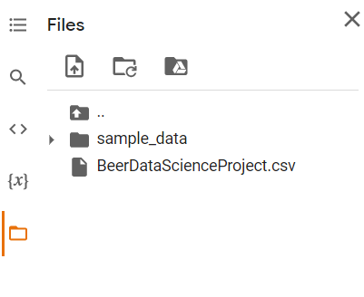
ii) click on files button
iii) click on upload to session storage button and upload the BeerDataScienceProject.csv file

Slide 41
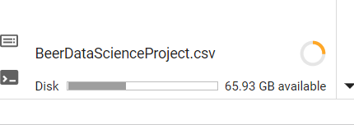
Note : Do wait until whole file is uploaded, as the file is 395 mb long , so it will take time, otherwise code may give an error
4) Once the file is uploaded , click on Runtime button and then Run All to get all the outputs automatically

Slide 42
THANK YOU

